Slide 1



The virtue of outreach
— does it pay off?
Sune Toft
Cosmic Dawn Center

Slide 2
Why spend time on outreach?
As an astronomer, most of our salary is paid by the public. It's only fair to give something back
We don't just do science for ourselves; we do it for humanity 😇
You learn a lot! Communicating your science to laymen requires you to really understand
It's rewarding. People are happy and thankful

Slide 3
Why spend time on outreach?
"Soft" values
As an astronomer, most of our salary is paid by the public. It's only fair to give something back
We don't just do science for ourselves; we do it for humanity 😇
You learn a lot! Communicating your science to laymen requires you to really understand
It's rewarding. People are happy and thankful
We show that our students thrive
Motivating for prospective students
Motivating for current students

Slide 4
A few cases
Student Albert Sneppen
punkt 1
punkt 2
Ass. prof. Gabriel Brammer
punkt 1
punkt 2

Slide 5
A few cases
Student Albert Sneppen
punkt 1
punkt 2
Ass. prof. Gabriel Brammer
punkt 1
punkt 2

Slide 6
How we do it
Hire an astrophysicist dedicated to outreach
Gives researchers more time for research
Ensures that the science is correct
Helps counteract the somewhat sad trend that science usually ends up being sensational. We would rather not bring a story than compromise our scientific integrity
Prepare news, press releases, stories specifically targeted at diverse audiences
News stories on our website: short, many new paragraphs and headings (since people read online and are busy), easily understandable
Facebook: Even easier, since most followers are busy non-scientist, but with link to the news story
Twitter: Very brief, slightly more sciencey, since most — but not all — followers are other scientists

Slide 7
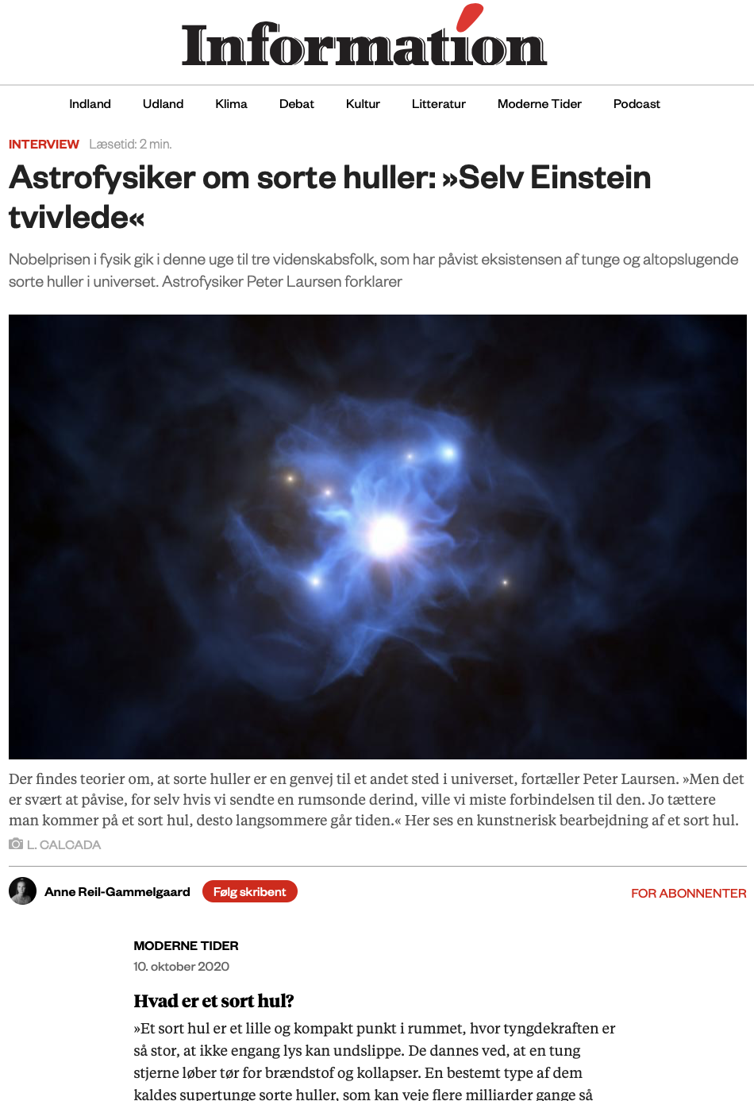
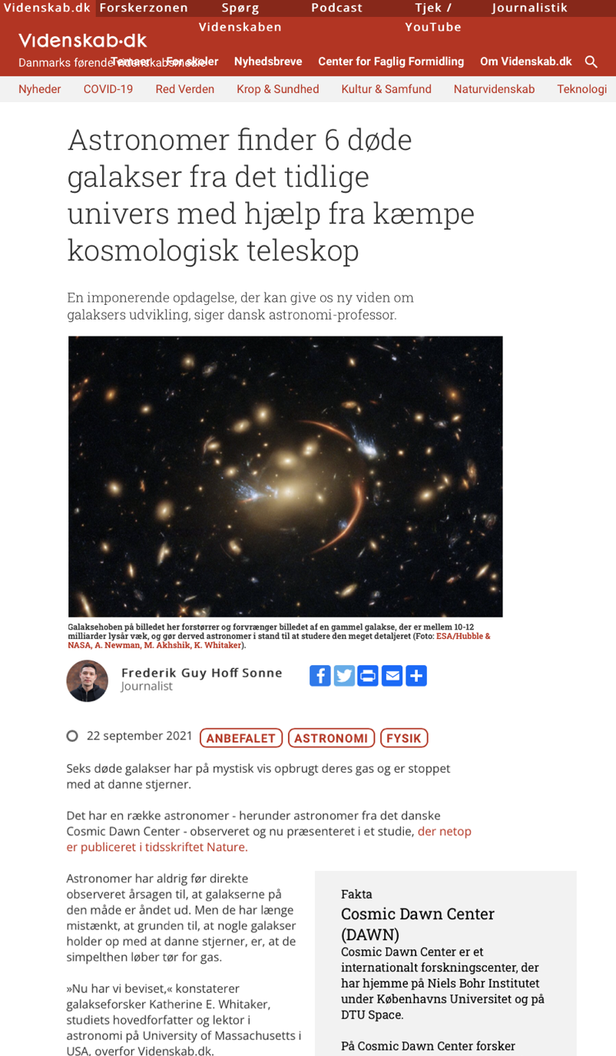
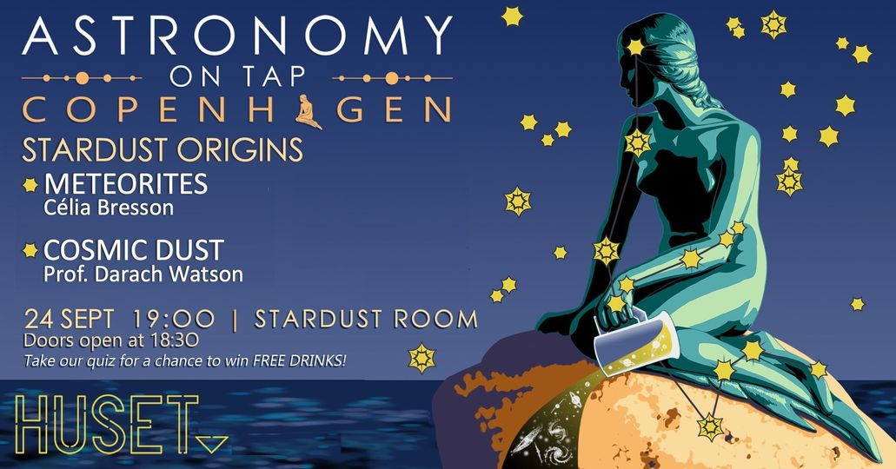
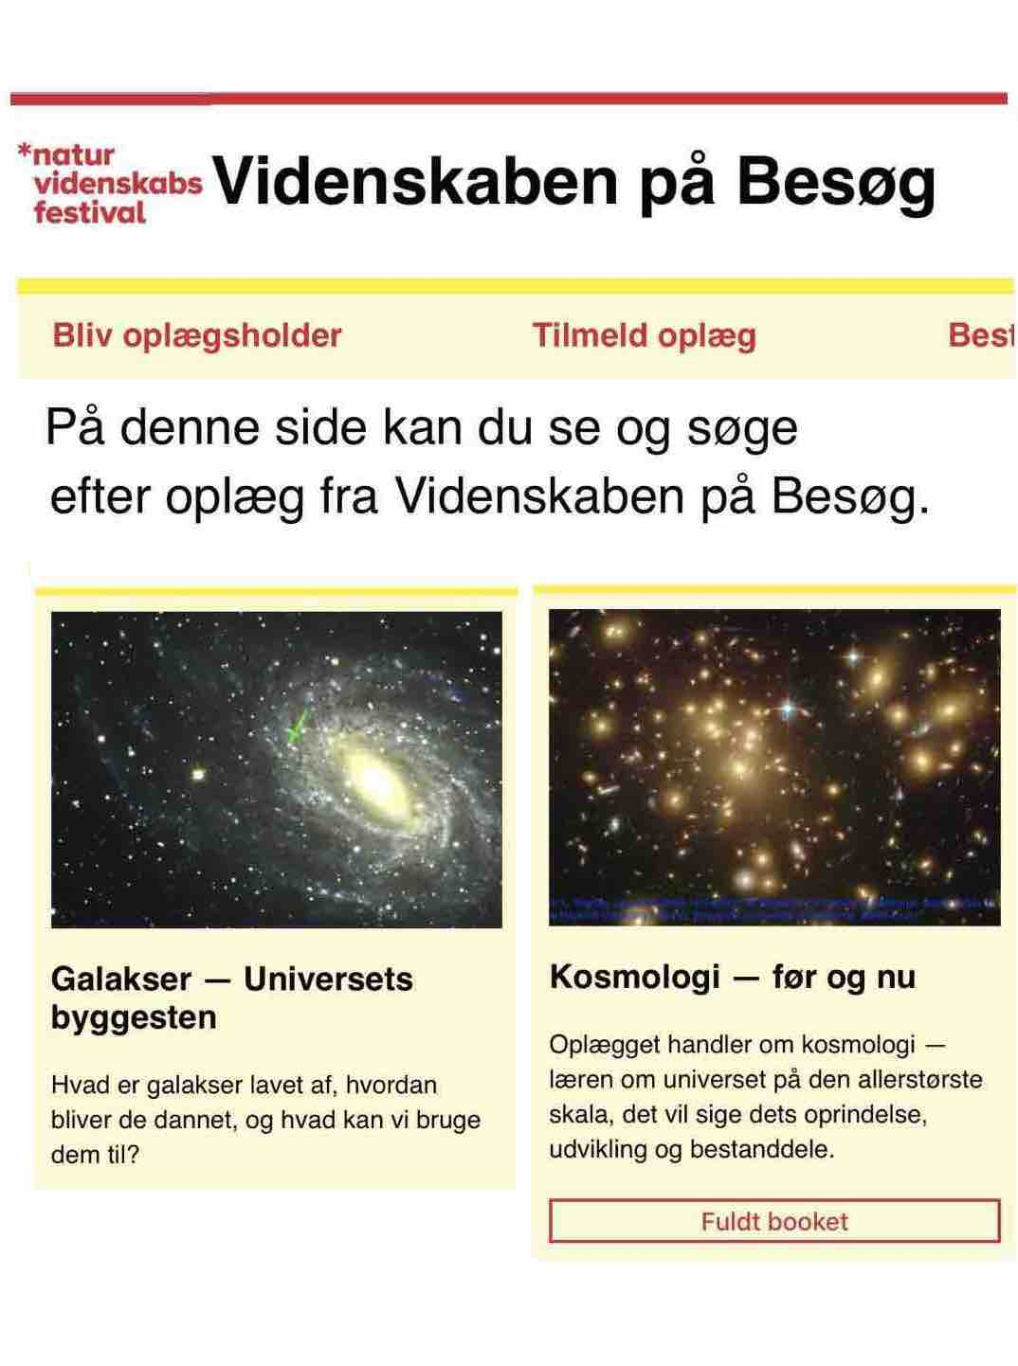
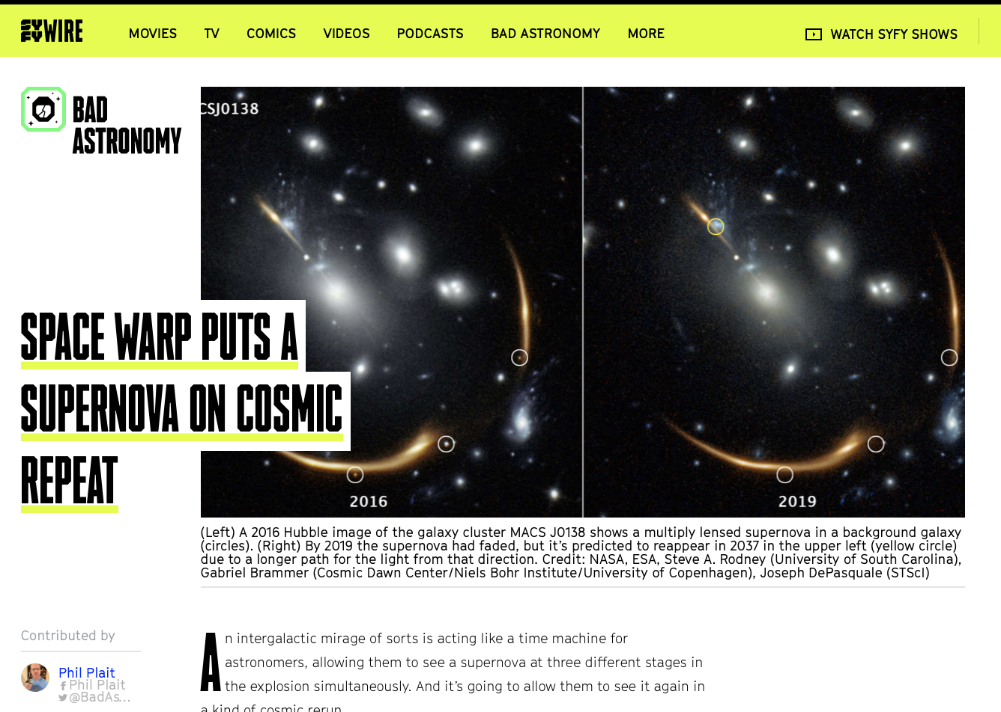
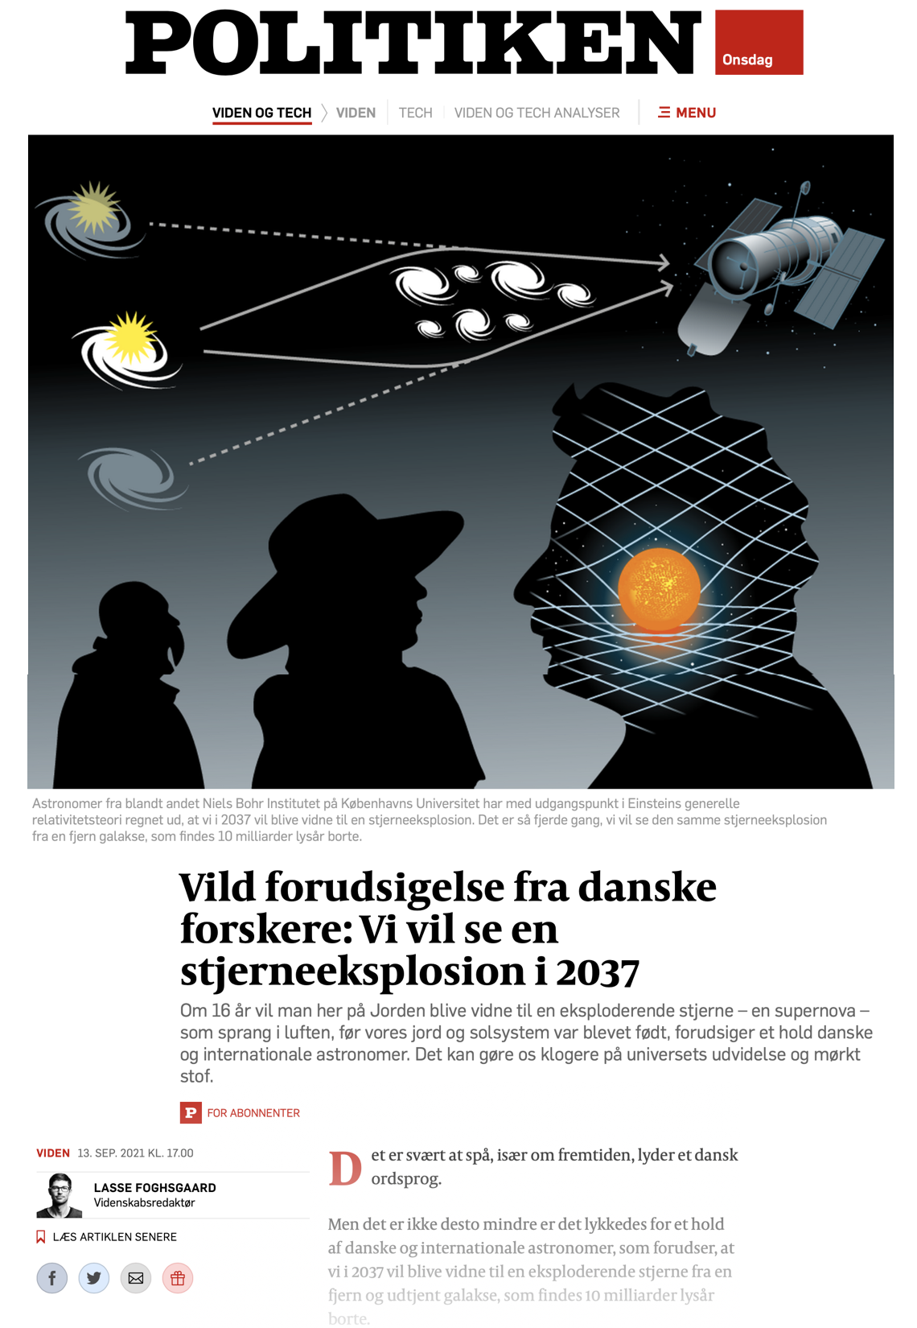
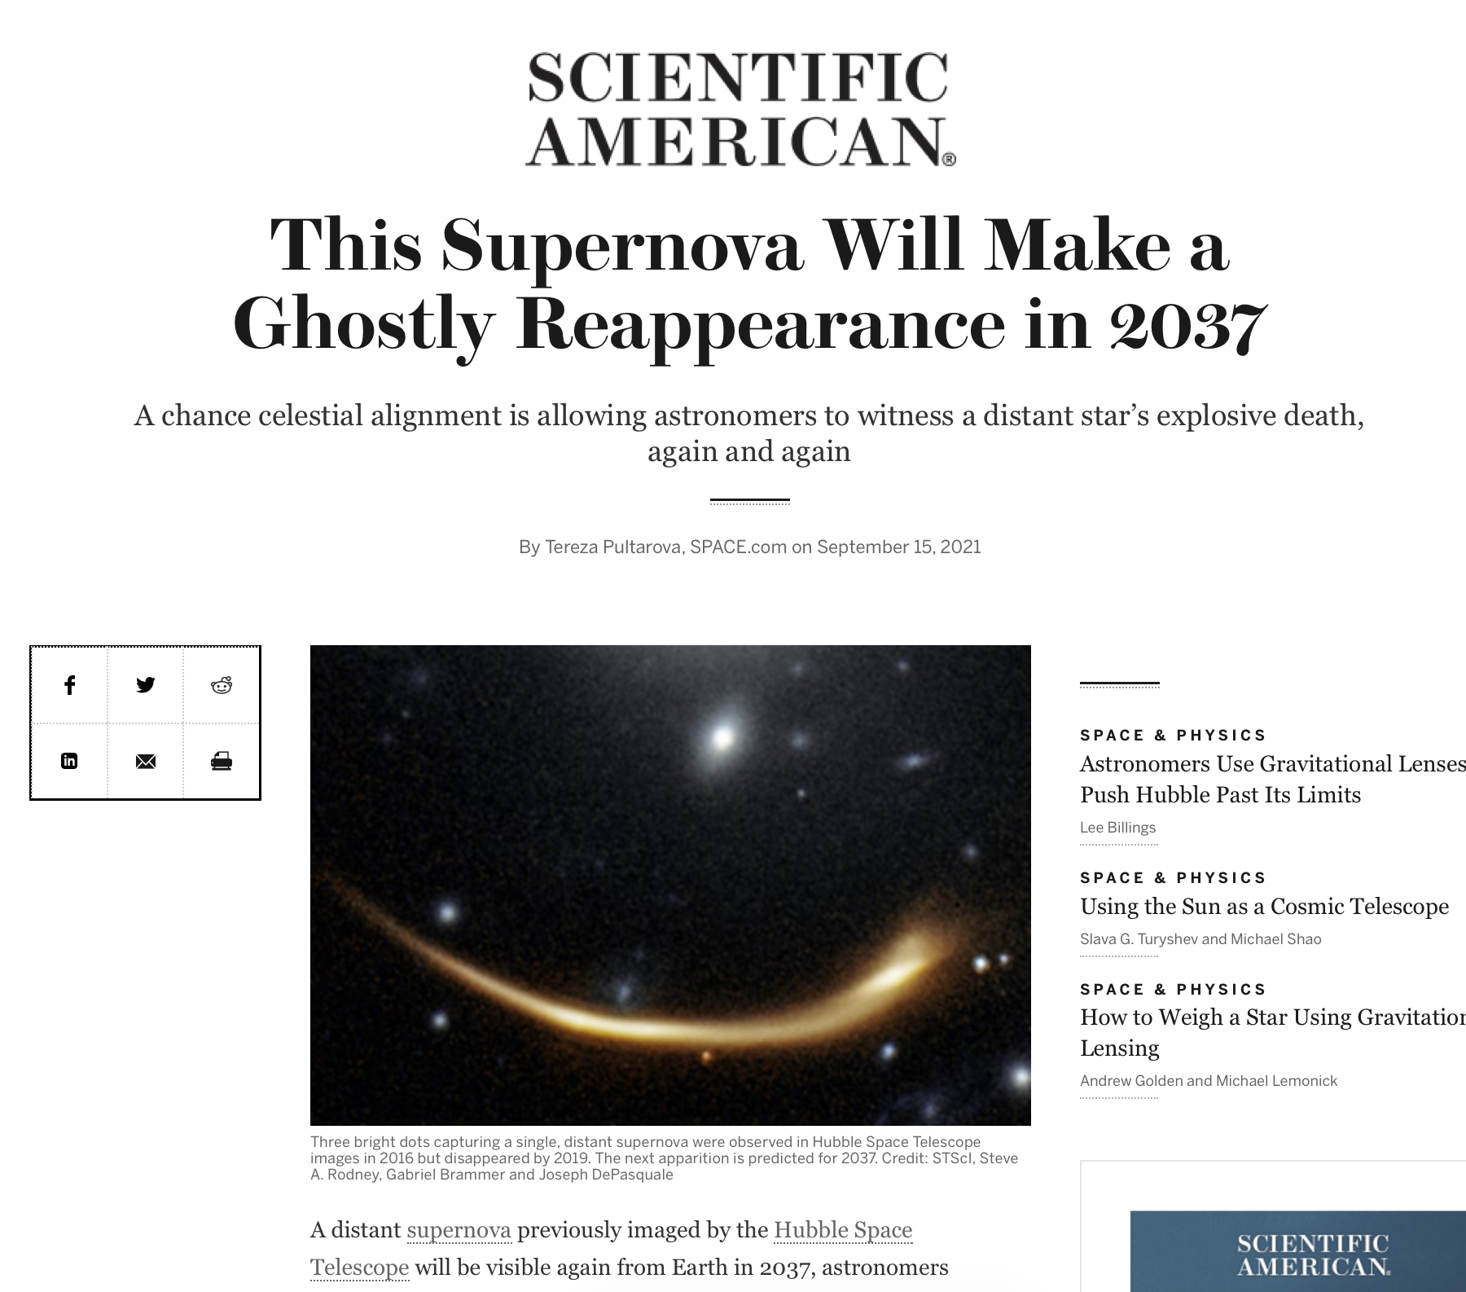

Outreach from DAWN
Public talks
High-school classes, amateur astronomy associations, libraries, pubs, kindergartens, …
In the media
Picked up from press releases or otherwise
Online science sites
Newspapers
Radio & podcast
TV
Uniavisen
Popsci articles
Q&A column

Slide 8
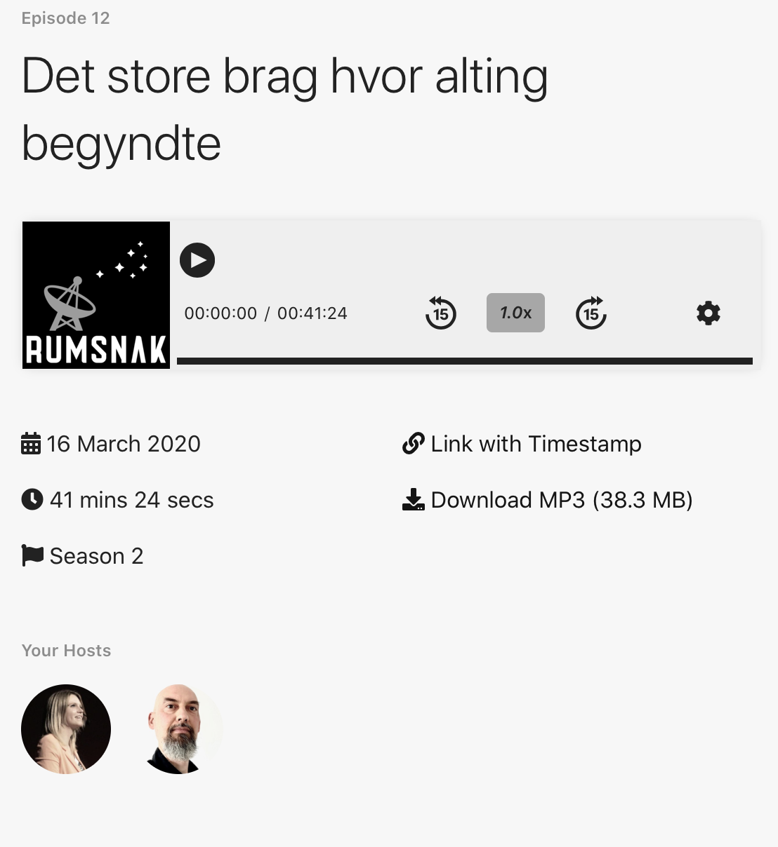
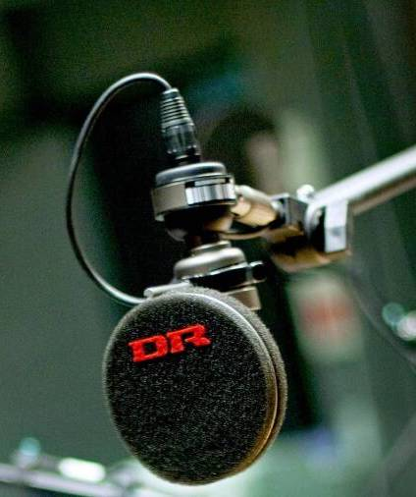
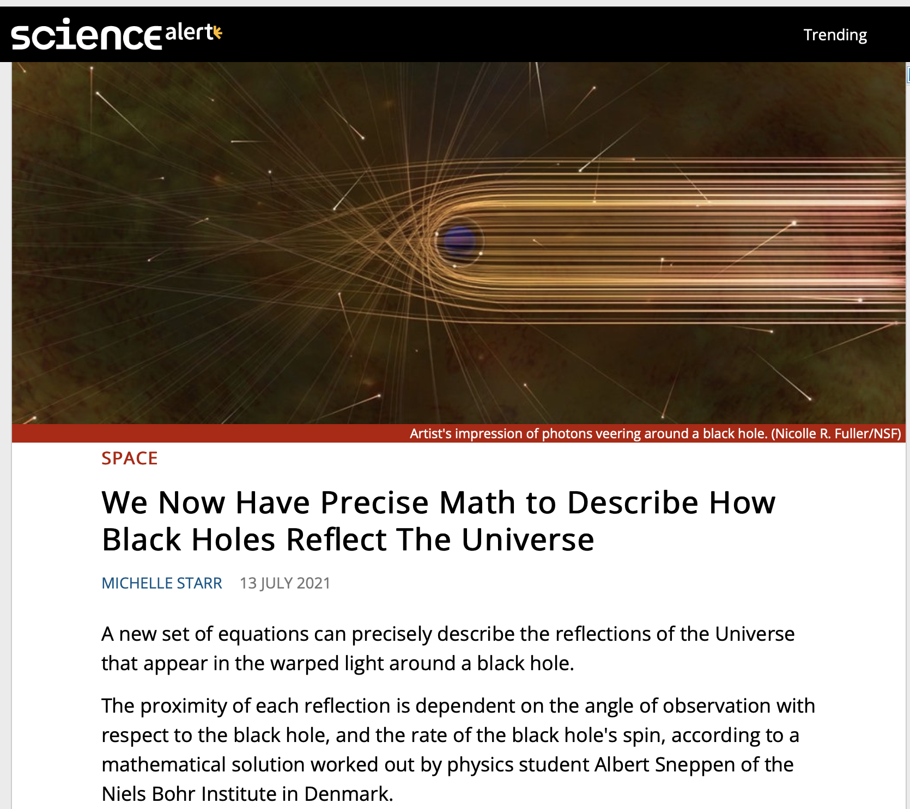
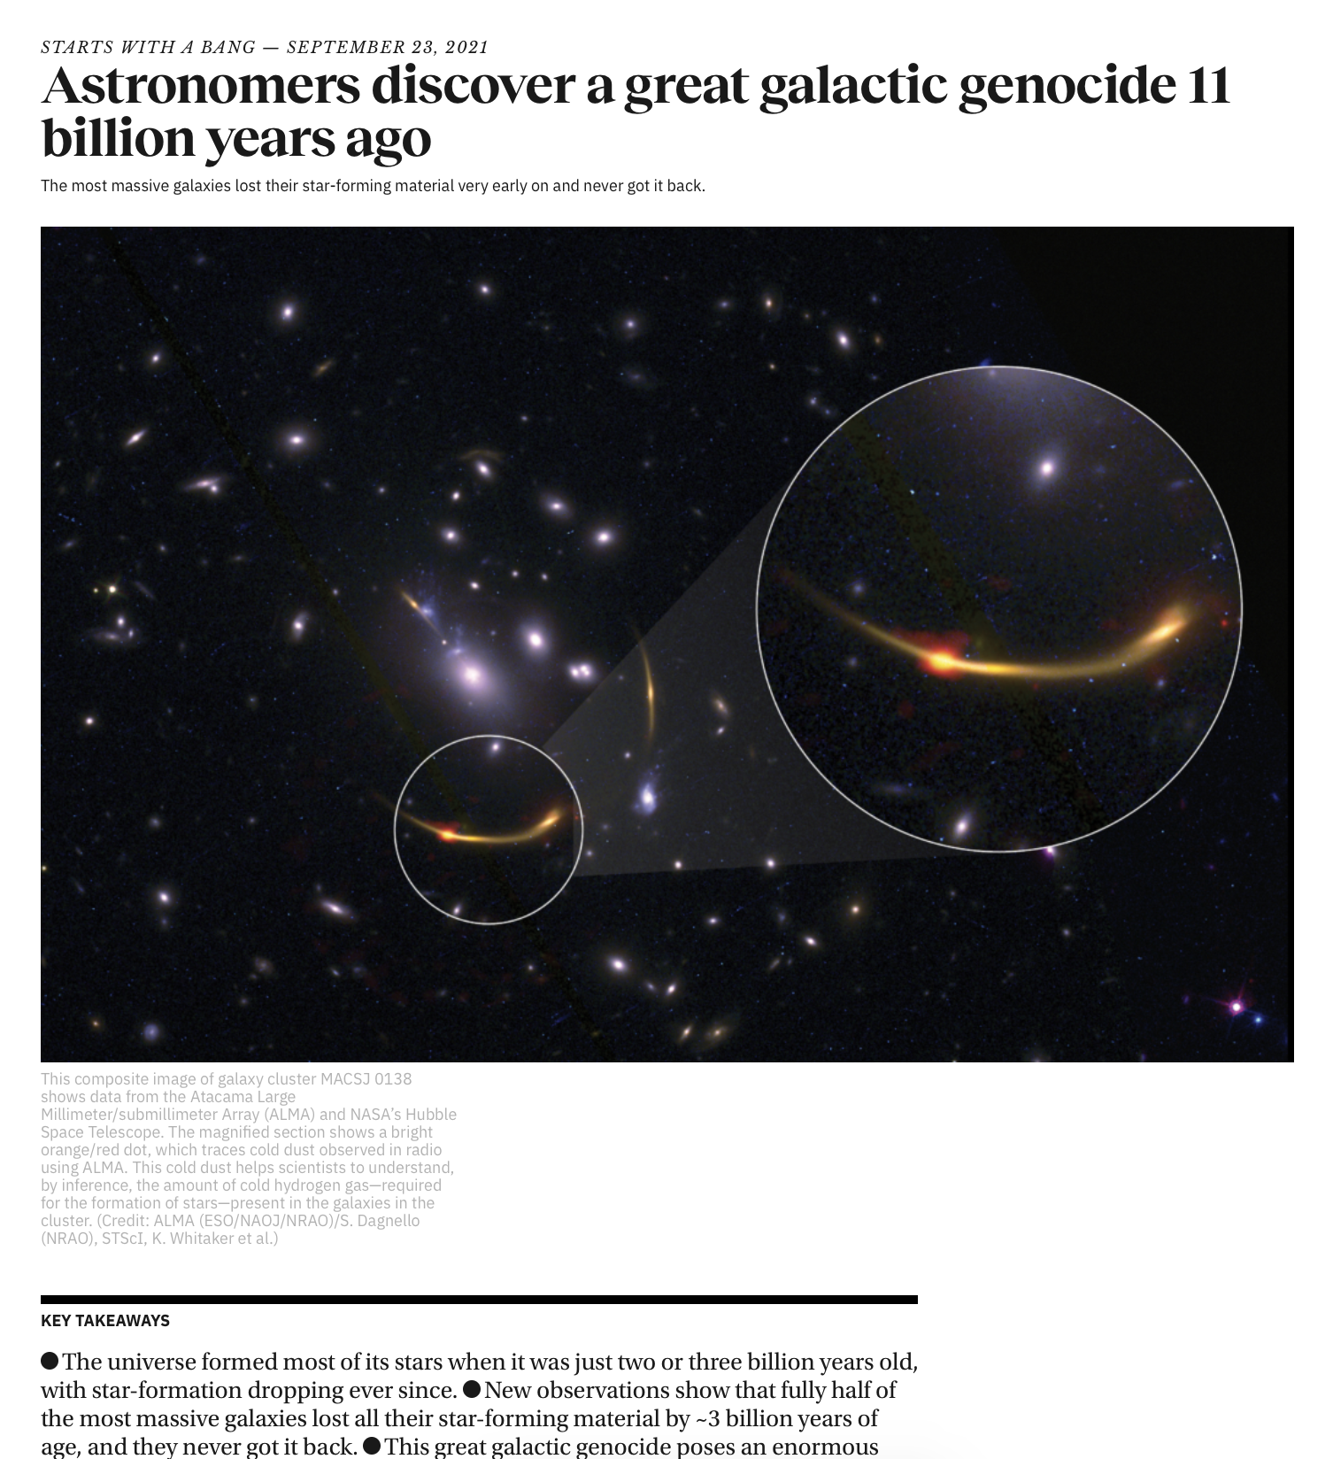
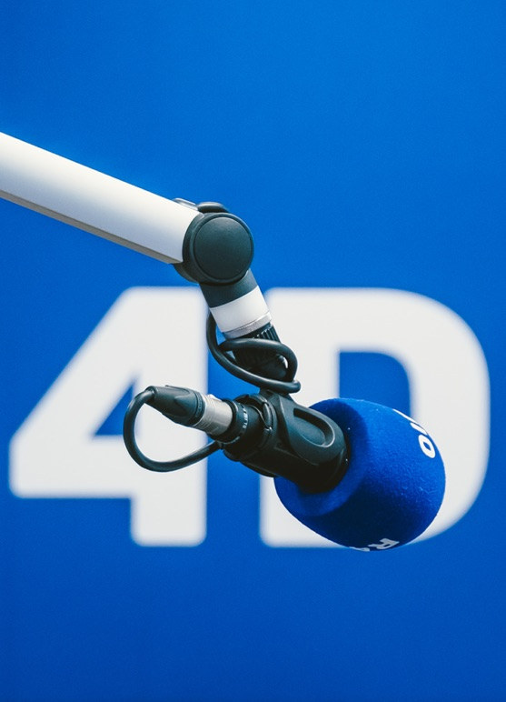
Outreach from DAWN
Public talks
High-school classes, amateur astronomy associations, libraries, pubs, kindergartens, …
In the media
Picked up from press releases or otherwise
Online science sites
Newspapers
Radio & podcast
TV
Uniavisen
Popsci articles
Q&A column
Skal ikke bruges

